Slide 1
Computer operations
KOHS Cyber Training Portal

Slide 2
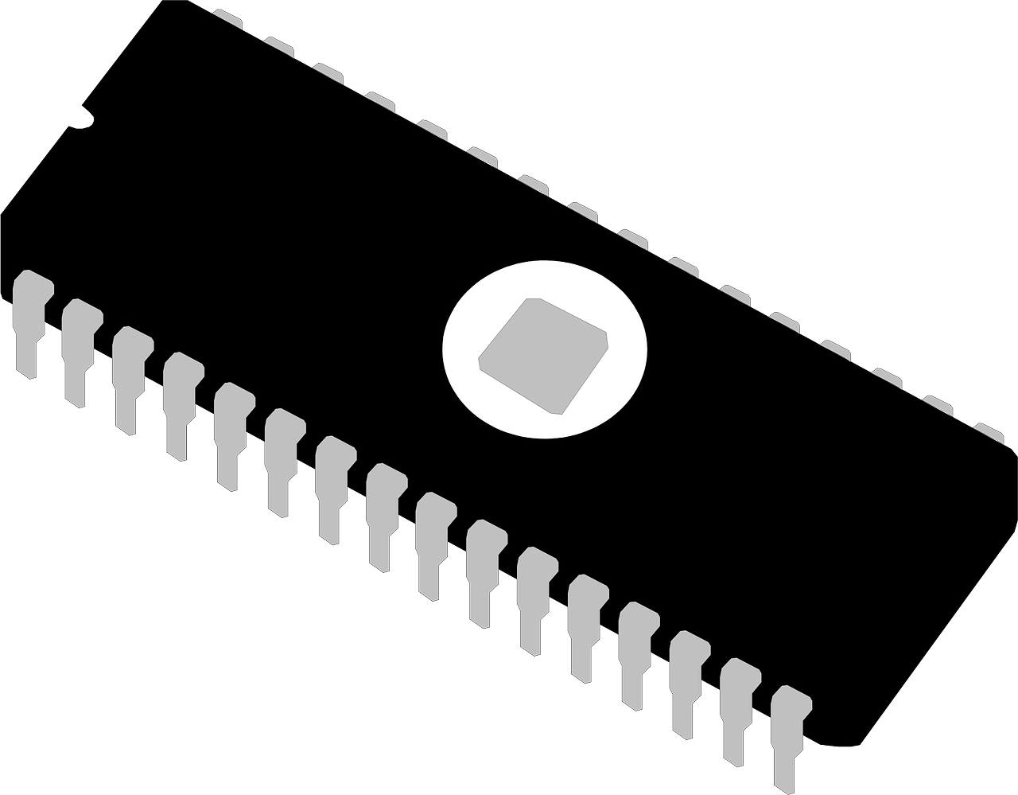
BIOS- Basic Input Output System
Software stored in motherboard
Very first software run when computer is started
Provide basic instructions vital to computer booting or start up
Identifies and allows for all of the computer hardware to work together

Slide 3
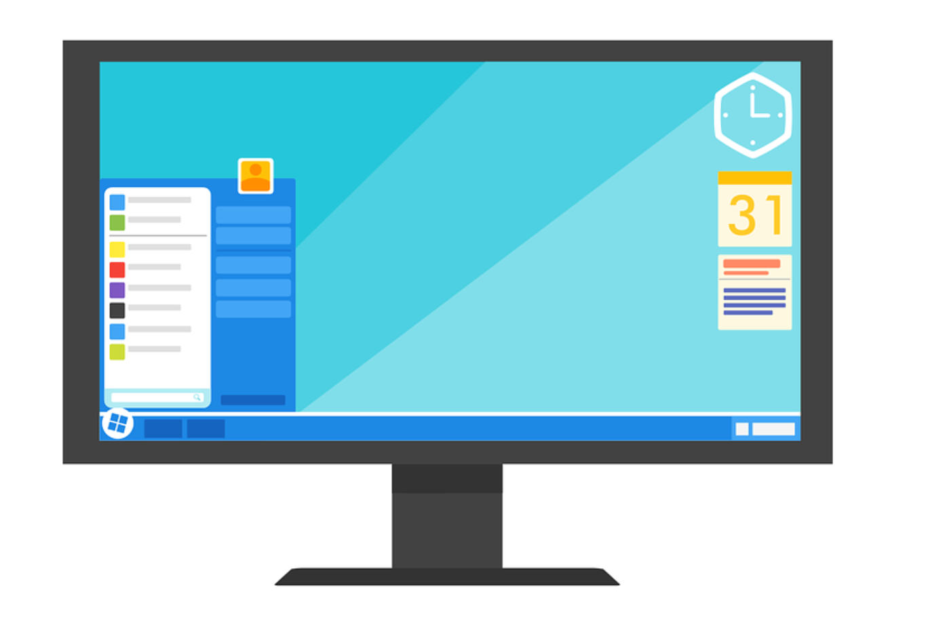
OS- Operating System
Large software program that manages input from hardware and works with other software on the computer
Examples include:
Microsoft Windows
macOS
Ubuntu
All computers, smartphones, and tablets run with an operating system

Slide 4

Applications
Program designed for user-end use
Cannot run without operating system and BIOS software
Can be delivered through the Web as a web application
Examples
Word processors
Database programs
Spreadsheets

Slide 5

User Interface
Bridge between the user and program, telling the program what to do
Two types:
1. command driven- you provide the computer with operations to preform
2. menu-driven- you select command choices from a set list
Graphic User’s Interface (GUIs)- include graphics like windows, symbols, and pop-ups as the command options

Slide 6
Game: loading software
Load the software types in the correct order for them to work:
Word application
1. BIOS (booting)…
Operating System
2. Operating System
UI/GUI
3. Word Application
BIOS (booting)…
5. UI/GUI

